Slide 1
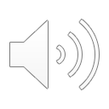
Crypto Link Senior Design Project
Easily created audio/video recordings
Securely back up your files with Google Drive API
Notes:
Hello, our senior design project is called Crypto Link. It is a web application that enables the user to easier record audio and video files and securely back them up through Googles Drive API.

Slide 2
Group Members:
Grant Galinger – galinggr@mail.uc.edu
Josh Phillips – phill2j7@mail.uc.edu
Kyle Spraggins – spraggkj@mail.uc.edu
Project Advisor - Dr. Nan Niu
Notes:
Our group members include myself, Grant Galinger, Josh Phillips, and Kyle Spraggins. Our project advisor is Dr. Nan Niu

Slide 3
Project Abstract
Our project is based around the idea of creating a web application geared towards creating audio and video recordings and allowing the user to automatically back them up through their Google Drive account. This application will allow the user, once they have been authorized through OAuth2.0 Authorization, to seamlessly create audio and/or video recordings directly within the app, and when finished, send them to their Drive account with use of the Google Drive API.

Slide 4
User Stories
As a content creator, I want the ability to quickly and easily record commentary so that I can spend less time editing
As a student, I want the ability to record video of myself so that my online class presentations go smoothly
As a teacher, I want my audio and video recordings easily backed up so that I don’t have to worry about losing valuable data
Notes:
A few examples of our User Stories based on our project are (read slide)

Slide 5
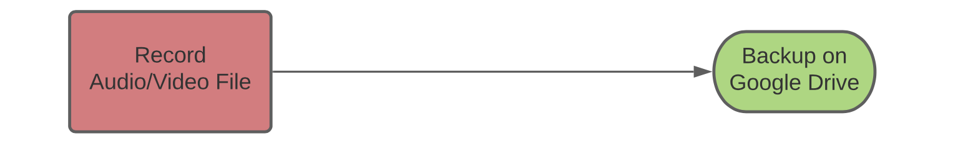
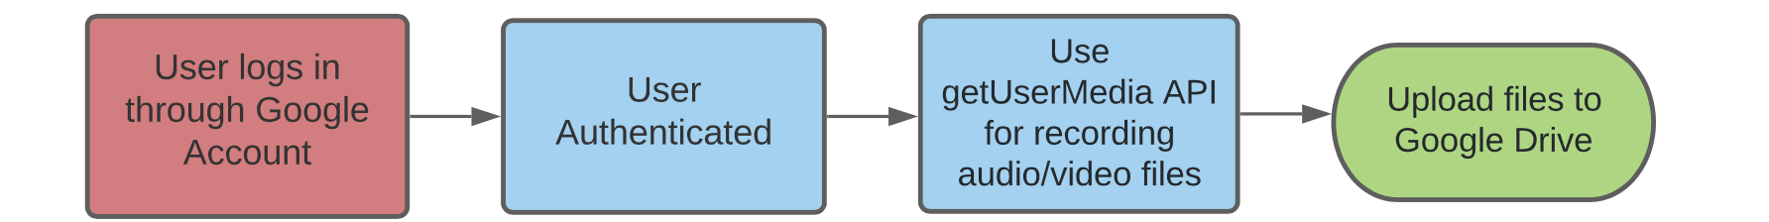
Design Diagrams
At the most basic level, this application will allow users to record and save audio and video files to their Google Drive account
More specifically, the application will be using the Google Drive API in order to access their Google Drive accounts.
Notes:
Here are two examples of Design Diagrams describing the processes within our application (read slide)

Slide 6
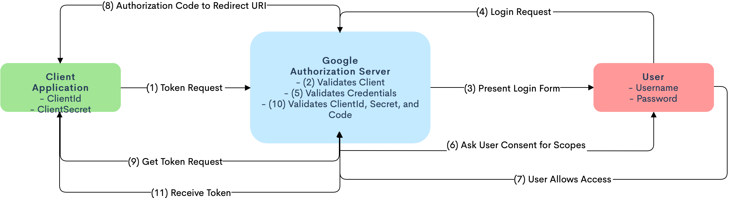
Design Diagrams Cont.
MORE specifically, this application will be utilizing OAuth 2.0 authorization to authorize users.
Notes:
Here is a more in-depth Design Diagram displaying how a user will be authenticated through OAuth2.0 authentication.

Slide 7

Major Project Constraints
Time – research and information gathering, deadlines, classwork
Expertise – JS, web apps, PHP, encryption, web design
Security - we will need strong encryption
Economic Cost - none
Scope - none
Ethical - none
Social - none
Environmental - none
Cultural Impact -none
Notes:
A list of major project constraints

Slide 8
Review of Project Progress
Working on OAuth2.0 Authorization for Google Drive Account
Working on establishing connection to php database
Working on designing the web application pages
Becoming proficient in web design and layout
Researching potential encryption methods
Notes:
Progress made thus far

Slide 9
Expected Accomplishments
A functional, secure, and aesthetically pleasing web application that satisfies our project goals
Become better and more knowledgeable software developers
Notes:
Expected accomplishments

Slide 10
Division of Work
Grant Galinger:
OAuth2.0 User Authentication
Php database implementation
Google Drive API Implementation
Josh Phillips:
GetUserMedia API implementation
Kyle Spraggins:
Overall application design and layout

Slide 11
Expected Demo at Expo
Working prototype or 1st release of Crypto Link
Demonstrate seamless audio and video recordings through web app
Demonstrate automatic backup to user’s Drive account using the Google Drive API

